Slide 1
Openlayers Workshop
by Sujana, 2020
https://github.com/Janns/ol-workshop

Slide 2
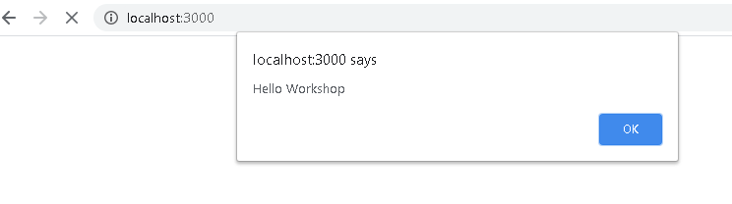
Persiapan
npm install
npm start
doc: http://localhost:3000/doc/
hasil aplikasi :
default : http://localhost:3000/
deployment: http://localhost:3000/latihan_build/
arsip source : http://localhost:3000/ latihan_source/

Slide 3
Dasar
OpenLayers mendukung berbagai jenis layers :
Tile layers for tiled raster tile sets
Image layers for static images or images that are provided on demand for the map's extent
Vector layers for vector data from static files for for the map's current extent
Vector tile layers for tiled vector tile sets
Pada OpenLayers, peta adalah kumpulan lapisan yang dirender ke halaman web.
Untuk membuat peta, Anda memerlukan beberapa markup (HTML) yang membuat viewport peta (mis. Elemen <div>), style, dan kode inisialisasi.

Slide 4
Dasar
index.html
<!DOCTYPE html>
<html>
<head>
<meta charset="utf-8">
<title>OpenLayers</title>
<style>
html, body, #map-container {
margin: 0;
height: 100%;
width: 100%;
font-family: sans-serif;
}
</style>
</head>
<body>
<div id="map-container"></div>
</body>
</html>
main.js
import 'ol/ol.css';
import {Map, View} from 'ol';
import TileLayer from 'ol/layer/Tile';
import XYZSource from 'ol/source/XYZ';
import {fromLonLat} from 'ol/proj';
new Map({
target: 'map-container',
layers: [
new TileLayer({
source: new XYZSource({
url: 'http://tile.stamen.com/terrain/{z}/{x}/{y}.jpg'
})
})
],
view: new View({
center: fromLonLat([113.4402284,-1.4862856]),
zoom: 10
})
});

Slide 5
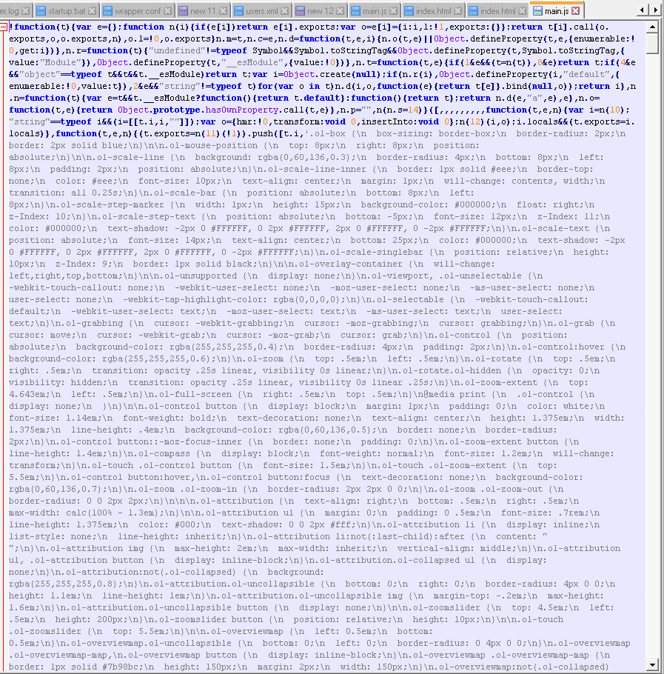
DEPLOY
Command Prompt:
jalankan : npm run build
perintah ini menjalankan webpack --mode=production
Output: folder build
Cek script .js yg dihasilkan Terenkripsi

Slide 6
Bekerja dengan Vektor

Slide 7
Rendering GeoJSON
index.html
main.js
<!DOCTYPE html>
<html>
<head>
<meta charset="utf-8">
<title>OpenLayers</title>
<style>
html, body, #map-container {
margin: 0;
height: 100%;
width: 100%;
font-family: sans-serif;
background-color: #04041b;
}
</style>
</head>
<body>
<div id="map-container"></div>
</body>
</html>
import 'ol/ol.css';
import GeoJSON from 'ol/format/GeoJSON';
import Map from 'ol/Map';
import VectorLayer from 'ol/layer/Vector';
import VectorSource from 'ol/source/Vector';
import View from 'ol/View';
new Map({
target: 'map-container',
layers: [
new VectorLayer({
source: new VectorSource({
format: new GeoJSON(),
url: './data/countries.json'
})
})
],
view: new View({
center: [0, 0],
zoom: 2
})
});

Slide 8
sinkronisasi
agar ketika re-load / refresh maka koordinat lokasi dan zoom tidak berubah
index.html
main.js
import 'ol/ol.css';
import GeoJSON from 'ol/format/GeoJSON';
import Map from 'ol/Map';
import VectorLayer from 'ol/layer/Vector';
import VectorSource from 'ol/source/Vector';
import View from 'ol/View';
//! [import]
import sync from 'ol-hashed';
//! [import]
const map = new Map({
target: 'map-container',
layers: [
new VectorLayer({
source: new VectorSource({
format: new GeoJSON(),
url: './data/countries.json'
})
})
],
view: new View({
center: [0, 0],
zoom: 2
})
});
//! [sync]
sync(map);
//! [sync]
sync.js

Slide 9
Drag and drop
note : -
index.html
main.js
import 'ol/ol.css';
import GeoJSON from 'ol/format/GeoJSON';
import Map from 'ol/Map';
import VectorLayer from 'ol/layer/Vector';
import VectorSource from 'ol/source/Vector';
import View from 'ol/View';
//! [import]
import sync from 'ol-hashed';
//! [import]
const map = new Map({
target: 'map-container',
layers: [
new VectorLayer({
source: new VectorSource({
format: new GeoJSON(),
url: './data/countries.json'
})
})
],
view: new View({
center: [0, 0],
zoom: 2
})
});
//! [sync]
sync(map);
//! [sync]
sync.js

